Slide 1
UNESCO´s activities in Bioethics National Bioethics Committees
Dafna Feinholz
Chief of Bioethics and Ethics of Science and Technology.
UNESCO, Paris.
Astana, May 12, 2005

Slide 2
UNESCO and Global Bioethics
Why UNESCO?
Bioethical issues not limited to national boundaries, nor to specific academic or professional field.
They call for inclusive, pluralistic approach.
UNESCO: multidimensional mandate in such areas as natural and social sciences, education, culture, philosophy, ethics, and human rights.
UNESCO: truly global platform that brings together 195 Member States.
Its focus on the common heritage of humankind: scientific and technological progress as a common public good, and as a means to achieve human and social wellbeing.

Slide 3
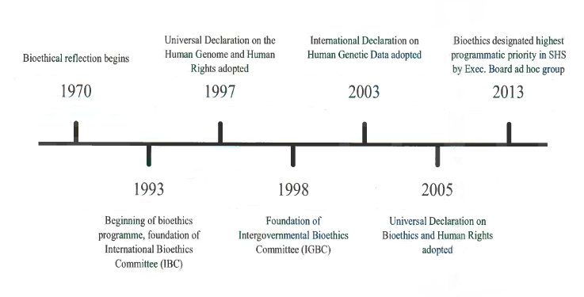
Programme Overview
and of
World Commission on the Ethics
of Science and Technology (COMEST)

Slide 4
Ideas to Action
From 1993-2005: Standard Setting Action
Universal Declaration on the Human Genome and Human Rights (1997, endorsed by the UN General Assembly in 1998)
International Declaration on Human Genetic Data (2003)
Universal Declaration on Bioethics and Human Rights (2005).
Dissemination, elaboration, implementation

Slide 5
Application of Principles: Capacity building:
Assistance in reinforcing the ethics infrastructures
Lack of well-developed capacities to deal with bioethics issues and problems.
Lack expertise: centres, committees, etc.
Lack of appropriate legislation, guidelines and teaching programs
Three practical projects:
Assisting Bioethics Committees (ABC) Institutional
Ethics Education Program (EEP) Professional
Global Ethics Observatory (GEObs)

Slide 6
Universal Declaration on Bioethics and Human Rights
Article 19. Ethics Committees
Independent, multidisciplinary and pluralist ethics committees should be established, promoted and supported at the appropriate level in order to:
a. Assess the relevant ethical, legal, scientific and social issues related to research projects involving human beings;
b. Provide advice on ethical problems in clinical settings;
c. Assess scientific and technological developments, formulate recommendations and contribute to the preparation of guidelines on issues within the scope of this Declaration;
d. Foster debate, education and public awareness of, and engagement in, bioethics.

Slide 7
National Bioethics Committee: What is and why is important
Operates at a national level with government recognition, formally established
Independent in its decision as has an advisory role
Members are acting in individual capacities, own TORS and are provided with appropriate budget and secretariat.
A committee that systematically and continually addresses the ethical dimensions of (a) medicine and the health sciences, (b) the life sciences, and (c) associated technologies
Policy advise: informing public policies.
Guide and initiate the establishment of other institutions: i.e. research committees.
Role in educations future generations: science, health systems, government policy, general knowledge for others
Informing and promoting public debate: what is at stake, expectations: participation and engagement from civil society.

Slide 8
BUILDING BIOETHICS INFRASTRUCTURE:
The rapid pace of scientific development today is necessarily examined by the various dialogues within wider society on the impacts of such development.
All countries, rich and poor, face challenges of the diversity of moral values of communities applied to the advancements in science and technology
All communities and their states require some capacity for reflecting on the moral aspects, and the human consequences:
of science and technology,
environment and medicine
Justice and equity allocating health care resources
Justice and equity in access to health care and advancements of science and technology
Biotechnologies need a publicly established response to uncertainty rather than a private one dominated by particular interests or discipline.
Approach of common good that promotes equity (respect for rights and fair distribution of benefits) , solidarity (avoiding social division, actively promoting the welfare of the less off) and sustainability (care for ecosystems & environment). (Nuffield Council)

Slide 9
BUILDING BIOETHICS INFRASTRUCTURE:
To ensure a moral consensus on the fundamental ethical grounds for the related policies and actions:
Communities and their states must decide when and how to regulate or guide– (rethink existing regulation or guidance)-- based on their most pressing moral concerns.
This exercise of ethics is an ongoing challenge: it is a process requiring dialogue that can be efficiently designed to deliver balanced, rational, reasonable and responsible responses.

Slide 10
Main Objective: To reinforce bioethics infrastructure in Member States through facilitating the establishment of national bioethics committees, and, once established, through the enhancement of their technical capacities
Assisting Bioethics Committees Project (ABC)
3 Steps of the ABC Project
Step I. Exploration and assessment of the existing bioethics infrastructure in the country
Step II. Technical support for the establishment of the national bioethics committee
Step III. Technical support for long-term sustainability
Since 2000 support to 17 countries establishing NBC. Currently assisting 14. We have conducted 21 training workshops in 10 countries for new NBC.
a. Technical capacity-building trainings
b. Partnerships, internships and networking
c. Provision of practical information

Slide 11
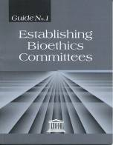
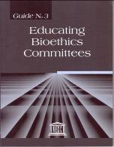
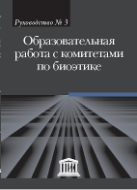
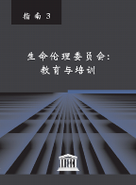
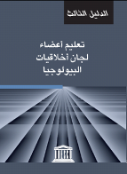
Assisting Bioethics Committees Project (ABC)
Step III. Technical support
c. Provision of technical information
Guide N°1: Establishing Bioethics Committees
Guide N°2: Bioethics Committees at Work: Procedures and Policies
Guide N°3: Educating Bioethics Committees
Guide N°4: Ethics Committees and Public Policies
Guide N°5: Ethics Committees and Public Debate
UNESCO Guides
Available in English, French, Spanish, Russian, Arabic, Chinese, Turkish

Slide 12
Assisting Bioethics Committees (ABC)
El Salvador (2010, 2012 and 2014);
Jamaica (2009, 2012 and 2013);
Kenya (2009, 2010 and 2011);
Côte d’Ivoire (2009, 2011 and 2012);
Gabon (2009, 2012 and 2014);
Guinea (2009, 2012 and 2014);
Togo (2009, 2012 and 2014);
Ghana (2009 and 2012);
Malawi (2012) Chad (2012 and 2014)
Malaysia (2013 and 2014)

Slide 13
Clearing House
Global Ethics Observatory (GEObs)
Provides database of ethics experts, committees, institutes, teaching programs and legislation
Freely accessible
In 6 labguages: Arabic, Chinese, English, French, Russian, Spanish
Database 1: Experts (510)
Database 2: Institutions, organisations, commissions (540)
Database 3: Ethics teaching programmes (235)
Database 4: Legislation (34 countries, 738 instruments)
Database 5: Codes of conduct (151)
Database 6: Resources in ethics (416)

Slide 14
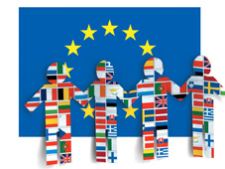
On going Work
IBC
Elaborating on Article 15 of the Universal Declaration on Bioethics and Human Rights (Benefit Sharing)
Updating reflection on human genome and human rights
COMEST:
Science and Society
Ethical Framework for Climate Change
Revision of 1974 Recommendation
EU Projects:
Satori
TRUST

Slide 15
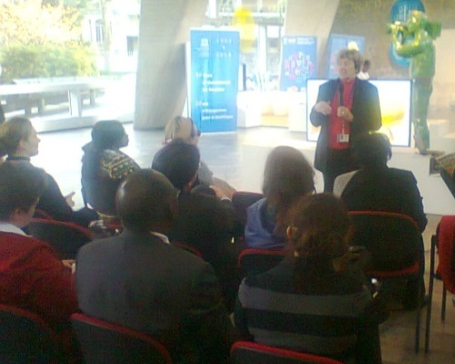
Ongoing work: Capacity-Building
Assisting Bioethics Committees (ABC)
Helps countries establish National Bioethics Committees
Argentina, Bolivia, Chad, Chile, Colombia, Congo, Cote D'Ivoire, Ecuador, El Salvador, Gabon, Ghana, Guinea, Jamaica, Kenya, Madagascar, Malaysia, Malawi, Namibia, Nigeria, Nepal, Oman, Togo, Tanzania, Uganda, Venezuela…
Professional trainings
Journalists, Judges, Parliamentarians…
Ethics Education Program (EEP)
Conducts ethics teacher training courses
Develops bioethics education resources
Azerbaijan, Belarus, Jordan, Croatia, Dubrovnik, Kenya, Lithuania, Namibia, Oman, Romania, Saudi Arabia, Slovakia, Serbia, Slovakia, Tanzania…

Slide 16
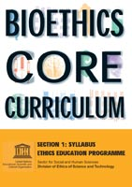
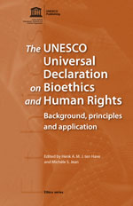
Main publications
IBC Reports
Consent
Social Responsibility and Health
Human Vulnerability and Personal Integrity
Traditional Medicine Systems and their Ethical Implication
Non-Discrimination and Non-Stigmatization
A Collection of Guides for Bioethics Committees
Guide N°1: Establishing Bioethics Committees
Guide N°2: Bioethics Committees at Work: Procedures and Policies
Guide N°3: Educating Bioethics Committees
Casebook series
Others
History, principles and Application of a Declaration
Global Bioethics: What for?

Slide 17
Dafna Feinholz d.feinholz@unesco.org Thank you!!

